Slide 1

SigmaShield
An AI-Powered Scam Detection Platform
Presented to you by: SG Biggest Sigma
Team Members: Lee Su Kiat Sean, Tong Teck Wee, Wang Zai Xi, Yang Zhenduo, Yang Zhenzhao

Slide 2

The Problem
In 2024, on average, someone in Singapore falls victim to a scam every 10 minutes

Slide 3
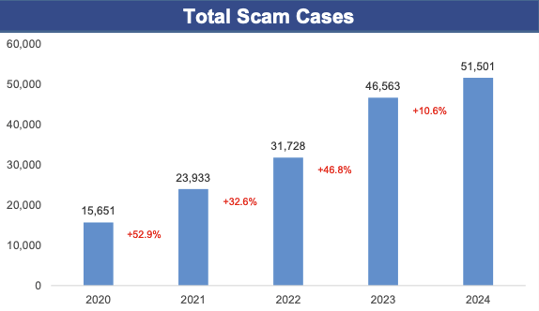
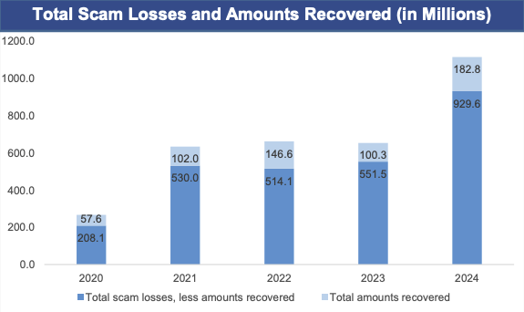
The Scam Crisis in SIngapore
Current Reality:
51501 scam cases in 2024
S$929.6 million lost to scammers in 2024
141 victims on average daily in Singapore
Only 16% recovery rate
Dangerous Trends:
Scam cases tripled since 2020
Losses quadrupled in 4 years
Increase year-over-year
Bottom Line: Traditional methods are failing. Singaporeans lose over S$3 million daily to scams (2024).
Singapore Police Force. (2025, February 25. Annual Scams and Cybercrime Brief 2024. Retrieved from https://www.scamshield.gov.sg/files/Scams%20and%20Cybercrime%20Briefs/2024_annual_scams_and_cybercrime_brief.pdf

Slide 4


Our Solution
SigmaShield, an AI-powered scam detection + community protection in your pocket

Slide 5
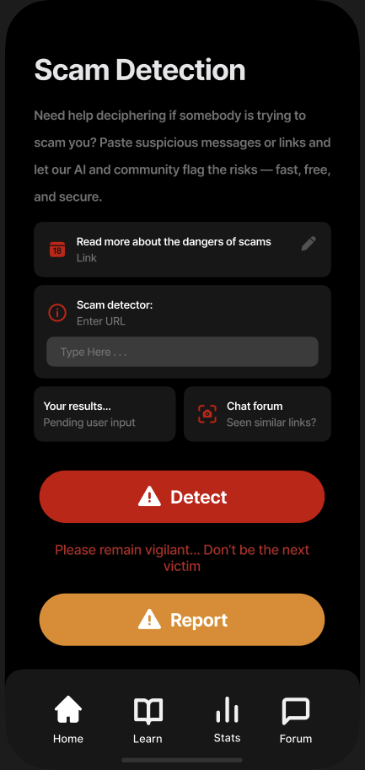
Scam Detection
Instant Analysis
Our AI scans messages, links, and suspicious content in real-time to identify potential scams before you fall victim
Advanced Detection method
We use smart AI technology and real user reports to quickly identify scams and provide detailed safety analysis

Slide 6
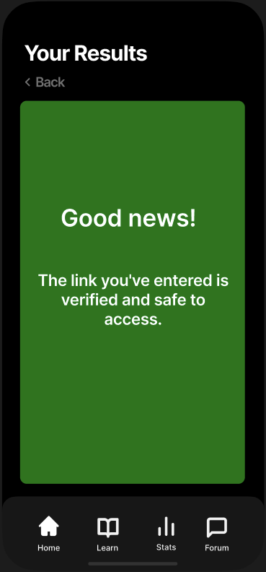
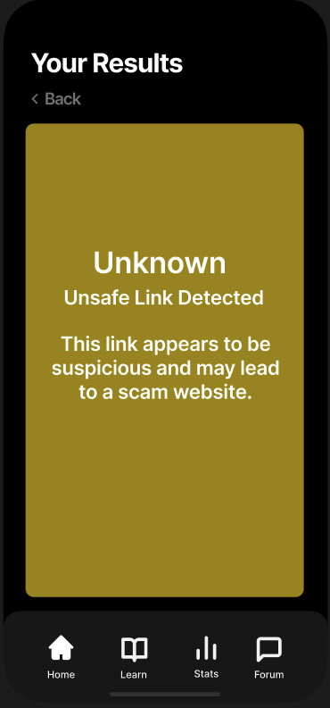
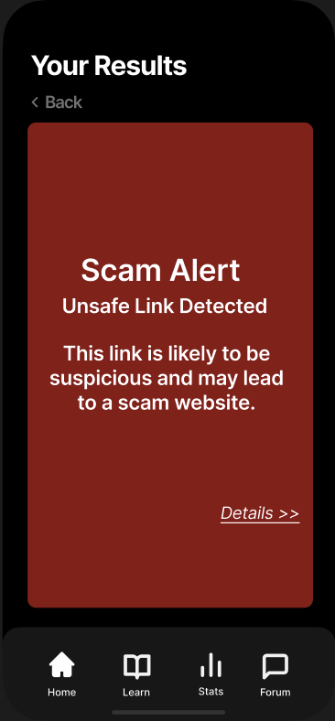
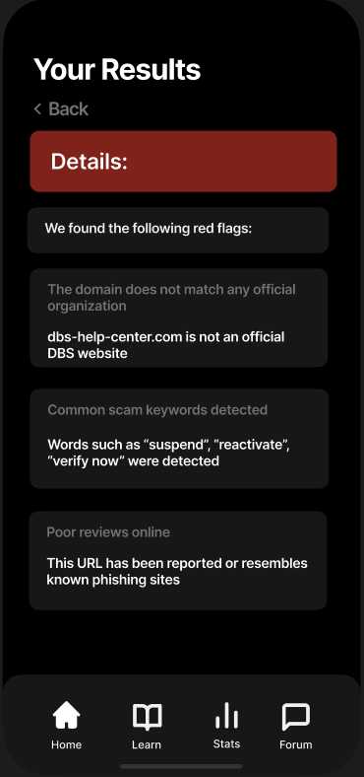
Scam Detection
Detailed results
Our app provides 3 clear result types with comprehensive analysis:
🟢 SAFE (Green)
Verified legitimate content
Clear "Good news!" confirmation
Safe to proceed with confidence
🟡 SUSPICIOUS (Yellow)
Potential risk detected
"Unknown/Unsafe Link" warning
Proceed with extreme caution
🔴 SCAM ALERT (Red)
Confirmed dangerous content
Detailed threat breakdown
Specific red flags identified
Community reports included
Plus Detailed Analysis:
Risk assessment explanation
Specific warning indicators
Community feedback data
Safety recommendations
Every scan gives you the full picture - not just a simple yes/no answer.

Slide 7
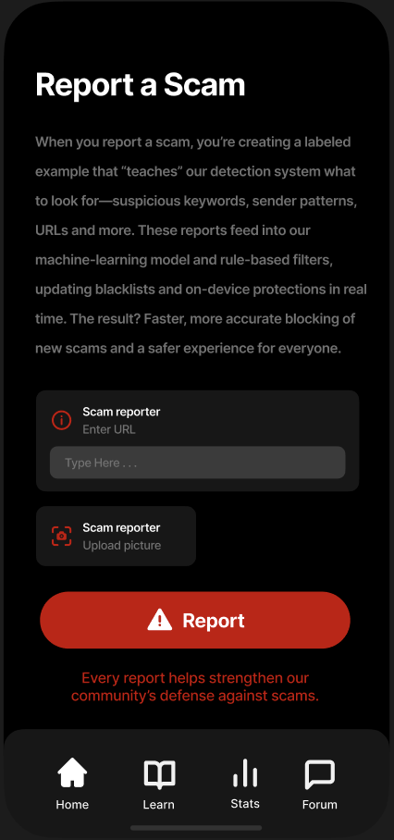
Scam Report
Easy Submission
Report suspicious URLs or upload screenshots
Simple one-tap reporting process
No technical knowledge required
AI learning
Every report trains our detection system
Improves pattern recognition accuracy
Updates protection in real-time
Community protection
Your report protects other users immediately
Builds comprehensive scam database
Strengthens collective defense

Slide 8
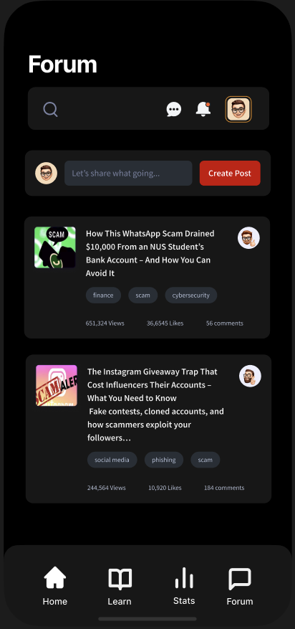
Community Forum
Real Experience
Share scam encounters and near-misses
Learn from others' experiences
Get advice from the community
Latest Scam Alerts
Trending scam discussions
New threat warnings
Real-time community updates
Educational Content
"How This WhatsApp Scam Drained $10,000"
"Instagram Giveaway Traps to Avoid"
Expert tips and prevention guides

Slide 9
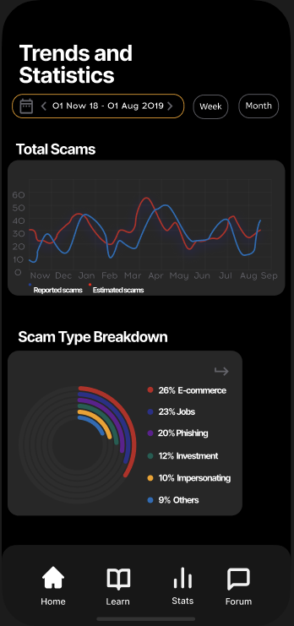
Trend and Statistics
Real-Time Monitoring
Track reported vs estimated scams monthly
Identify seasonal patterns and spikes
Monitor community reporting effectiveness
Key Benefits
Stay informed about current scam trends
Understand threats in your area
Community awareness through shared data
Prevention insights based on real patterns

Slide 10
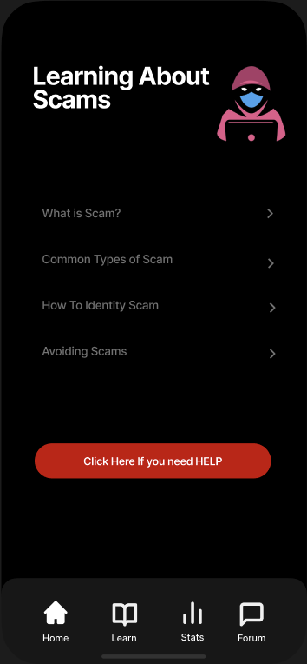
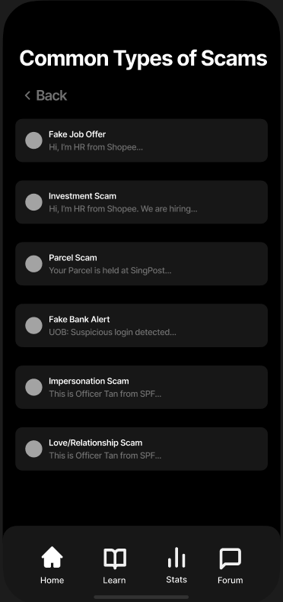
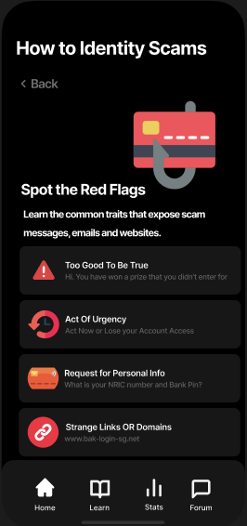
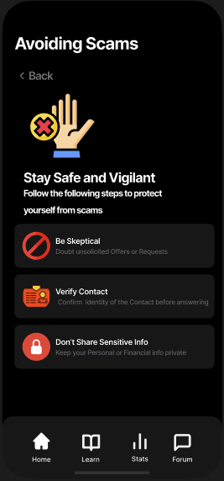
Learning about Scams
Scam Knowledge Base
What is a Scam? - Basic definitions and concepts
Common Types of Scams - 6 major categories with examples
Real scam annotations with detailed breakdowns
Real Scam Examples
How to Identify Scams - "Spot the Red Flags" guide
Avoiding Scams - "Stay Safe and Vigilant" strategies
Interactive examples with SMS screenshots
Interactive Education
Help & Hotline - Direct access to Singapore authorities
999 emergency line integration
Official ScamShield website and support contacts

Slide 11
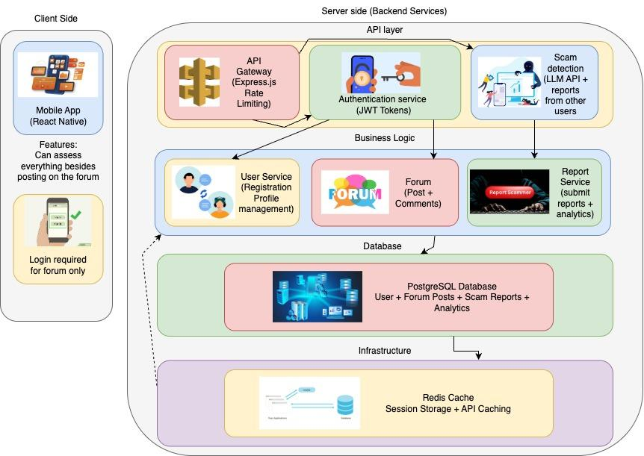
Architecture

Slide 12
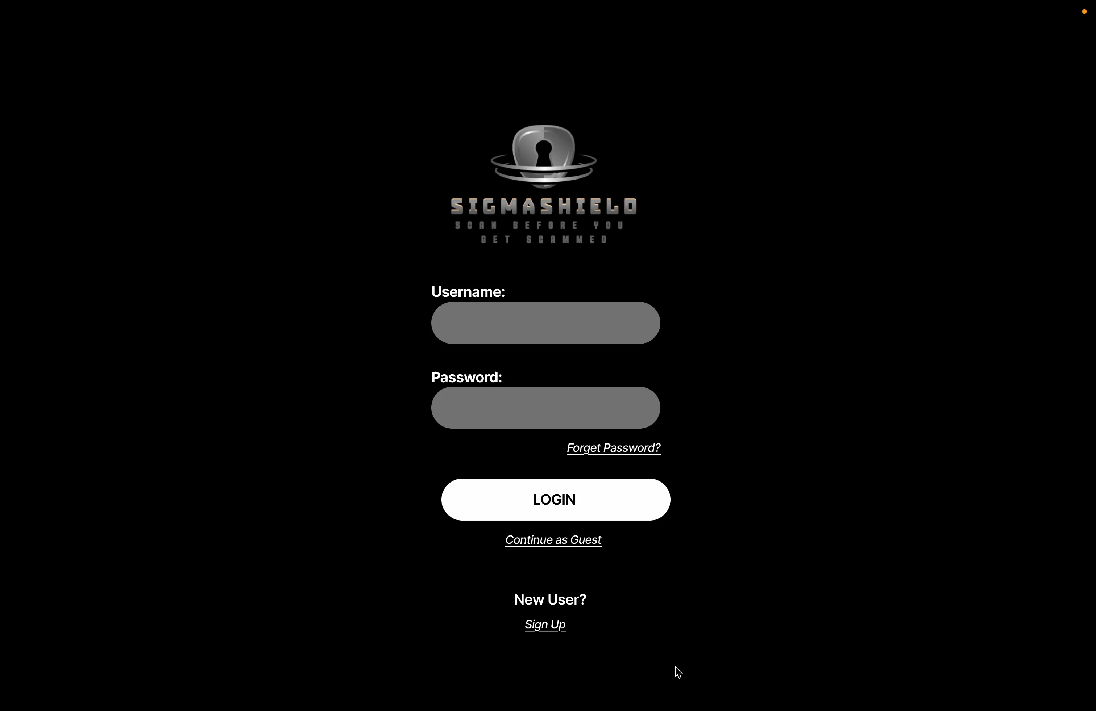
Wireframe Demo

Slide 13
Thank You For Your Attention
Do you have any question?

